Slide 1

Manually Moving Depalleter
5.20.24 version 1.0

Slide 2
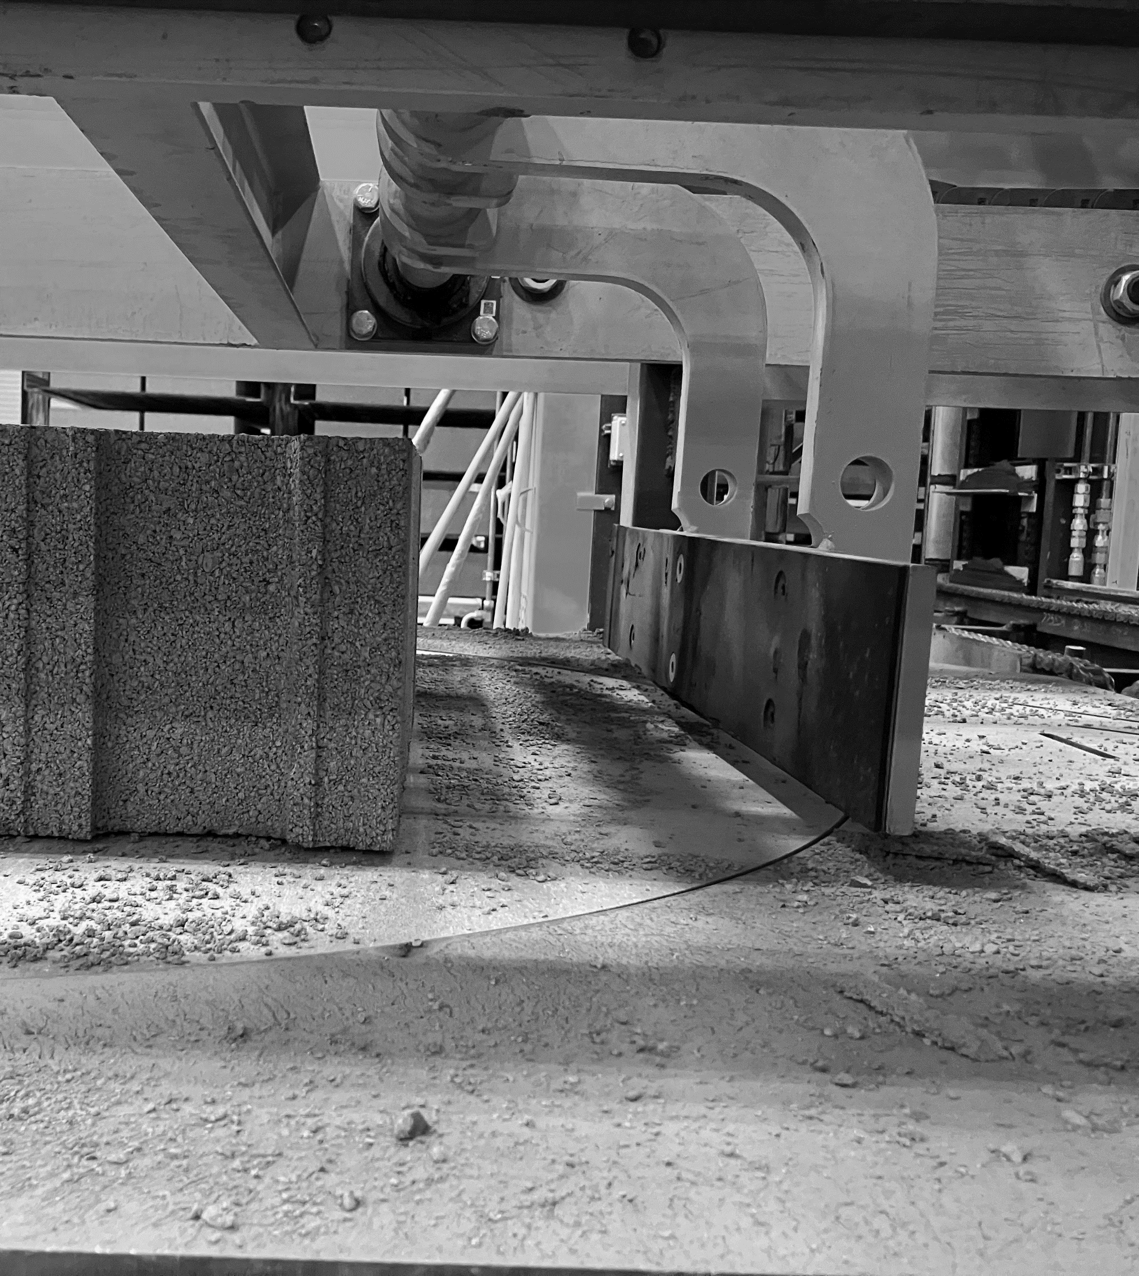
Assumptions and Prerequisite Skills
Machine is not running because a part is broken
Supplies Needed
Standard PPE

Slide 3
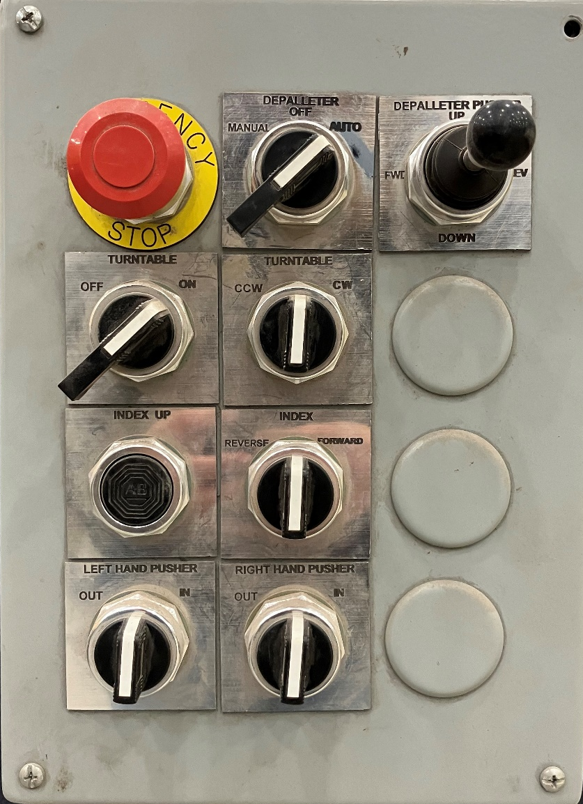
1. To manually move, turn the “Depalleter” dial to “Manual” (red circle in Figure 1).
Figure 1

Slide 4

2. After turning the Depalleter to Manuel”, push in the “Index Up” button (yellow arrow in Figure 2). While holding this button in, move the “Index” dial either forward or reverse to move the pusher feet forward or backwards (red arrow in Figure 2).
Figure 2

Slide 5

3. After using the feet to move the blocks up, release the “Index up” button and use the “Index” dial to reverse the feet to their original position.
4. Next turn the “Right Hand Pusher” to “In” to move the right-hand pusher to push the blocks to the middle of the area (red circle in Figure 3). Stop when the light appears on the bolt. Then switch the dial to “out” until the pusher is completely back.
c
Figure 3

Slide 6

5. For the ‘Left hand pusher’, turn the dial to “in” until blocks are aligned with the first set of blocks (red circle in Figure 4). Make sure to move the pusher out again after the blocks are aligned.
6. Turn Depalleter back to “auto”.
This completes the process.
Figure 4

